Slide 1
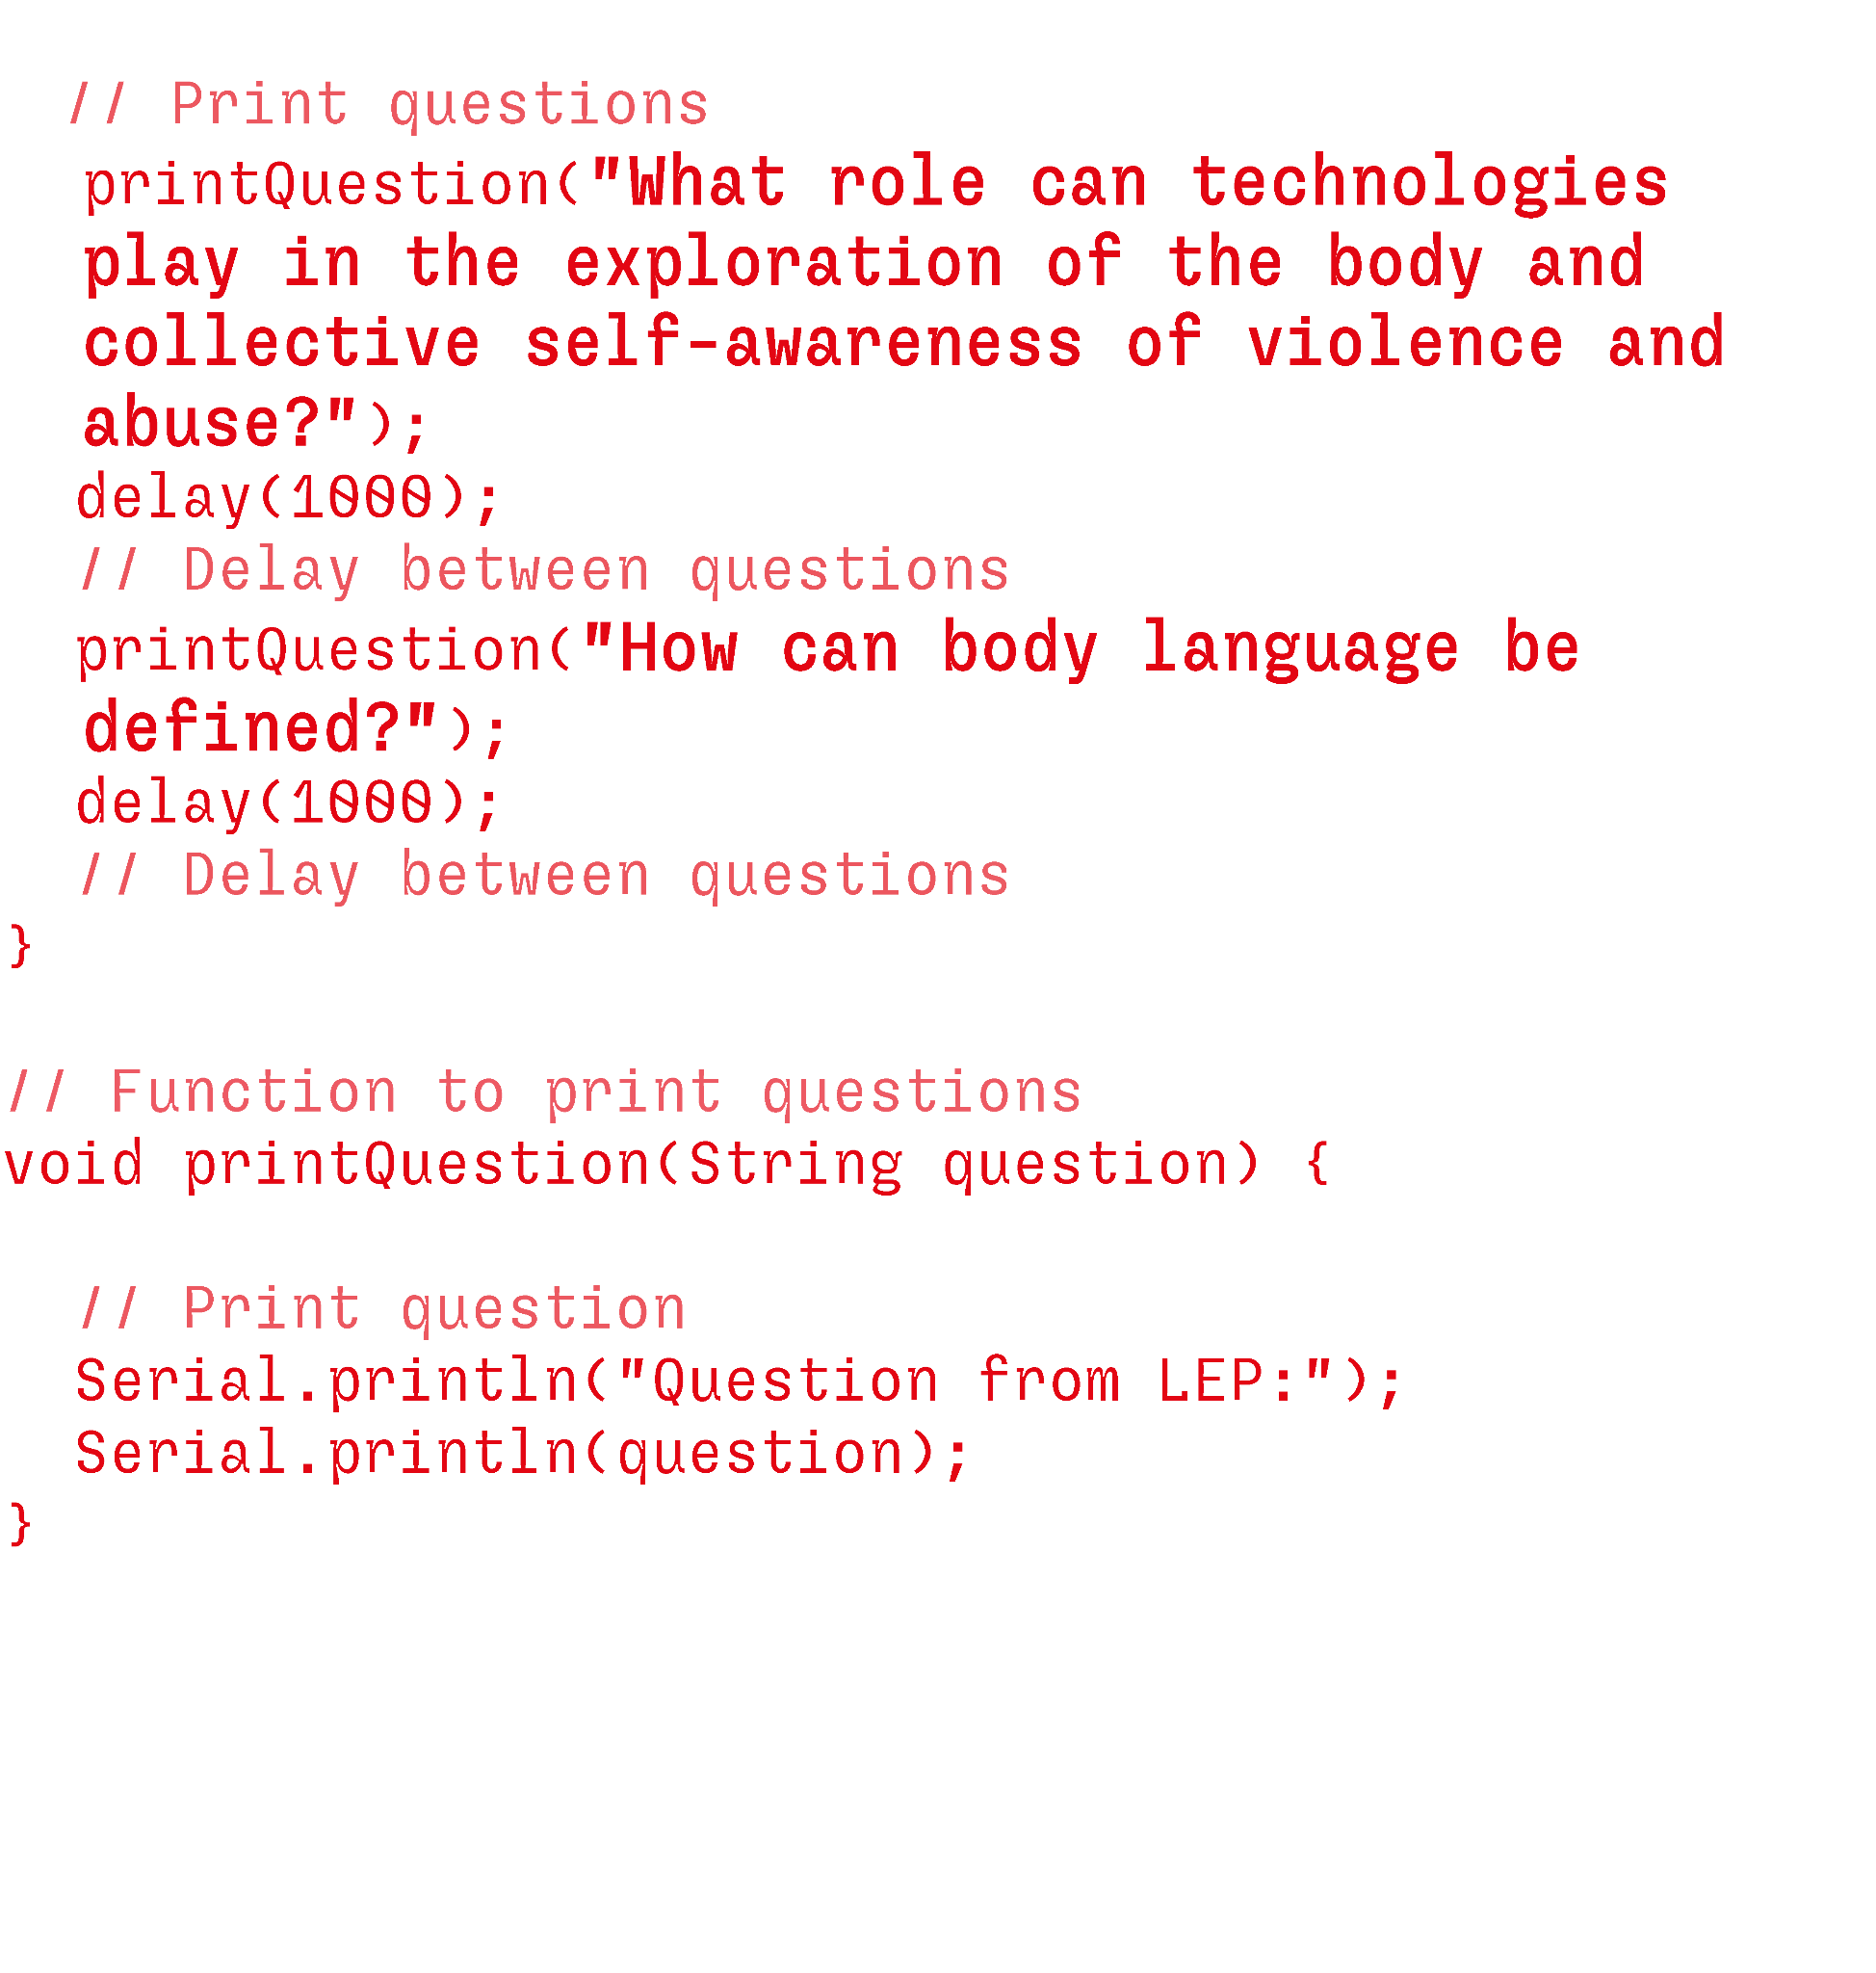
<body>
Communicating ideas presentation Anna Fedele

Slide 2
what is it?
vision
Envision a future in which technology, translated as data collection, can play a key role in society's self-awareness of gender-based violence and in the immediate when there are confusing dynamics
The project is a speculative reflection and application of the role of technology in the delicate topic of gender-based violence.
The project combines, the reliability of sensors and technology with the primitive dynamics between bodies, in order to create a collective self-awareness of the topic and its patterns.
mission
I want to research and explore the dynamics of the relationship between one or more bodies through the use of sensors that are able to define body language in a situation of violence for both sides
purpose
Establishing conversations and awareness among individuals on the issue so that technology and transhumanism is the key vehicle for resolving and clarifying events of physical violence
Communicating ideas presentation Anna Fedele

Slide 3
Values
and
self-respect
love
tone
security
justice
openness
community
serious
energetic
growth
trendy
risk adverse
reserved
progressive
Communicating ideas presentation Anna Fedele

Slide 4
40%
30%
20%
10%
caregiver
lover
magician
innocent
archetypes
I take care of other people’s sensitivity and convenience
I base our research on emotions related to physical actions
I believe in a social change based on collective self-awareness
I look for transparency and honesty in the final output
Communicating ideas presentation Anna Fedele

Slide 5
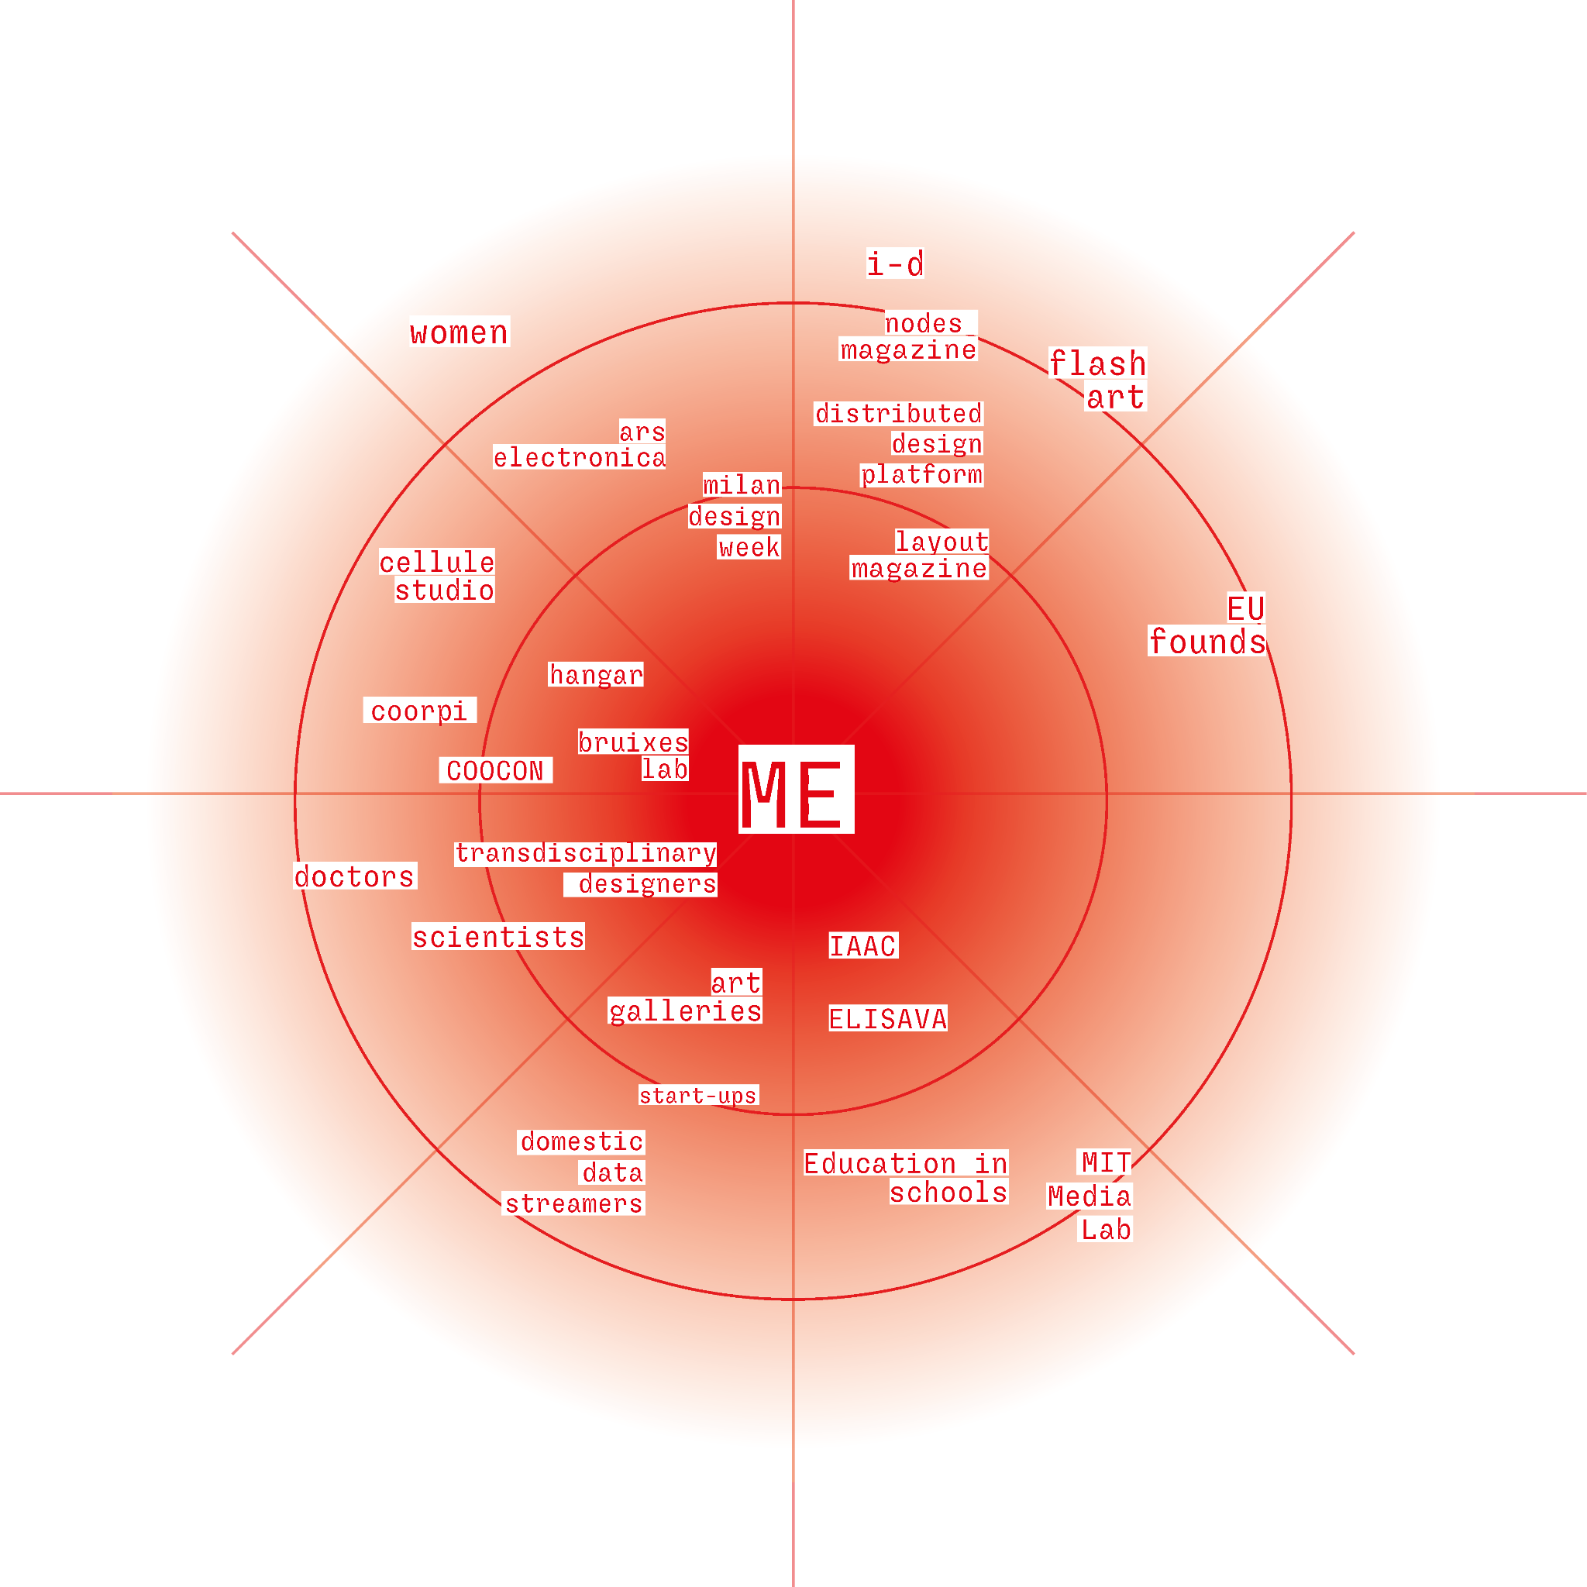
stakeholders
Educational institutions
Studios and collectives
Artistic places and cultural exhibitions
Communicating ideas presentation Anna Fedele

Slide 6
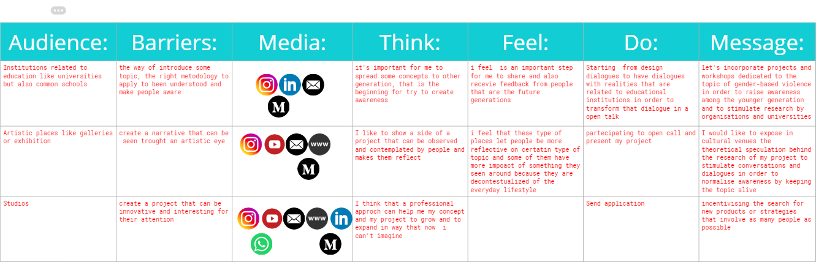
Communication matrix
Communicating ideas presentation Anna Fedele

Slide 7
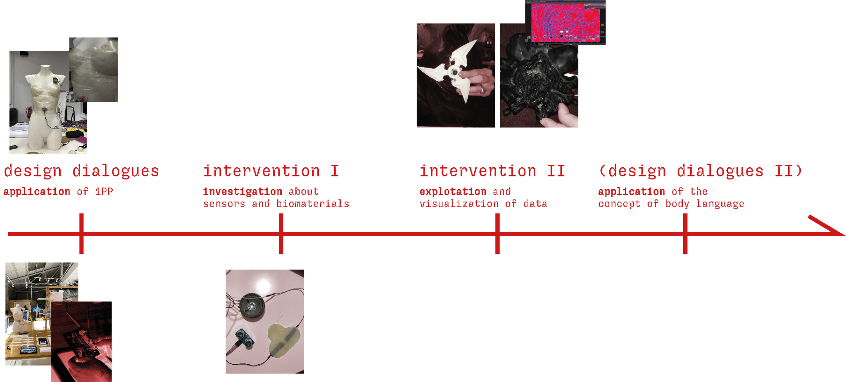
Where am i until now?
Communicating ideas presentation Anna Fedele

Slide 8
Where am i until now?
Communicating ideas presentation Anna Fedele

